Slide 1
Alternative Learning Trajectories Toward Understanding Matter and Energy in Socio-Ecological Systems
Hannah Miller, Allison Webster,
Jenny Dauer, Andy Anderson

Slide 2
Levels of Achievement
Level 4: scientifically principled reasoning
Level 3: “messy middle”
Level 2: force-dynamic discourse
Notes:
MESSY MIDDLE: many students stuck at L3. L2-L3 ok, L3-L4 harder.

Slide 3
Undergraduate pre-service elementary teachers
Matter
Energy
Matter/Energy
In Context
Notes:
Population:
Course: Principles-first instruction, have noticed interesting things about how students reason about matter & energy
Items: designed to elicit reasoning about matter and energy
Coding Transcripts: interested in these 4 things

Slide 4
Interviews
Level 4
Fact-Oriented Level 3
Principle-Oriented Level 3
Jake
Allen
Level 2
Notes:
Across Items, Jake & Allen are Level 3 students who are very different from each other. We want to show you the patterns we noticed in their thinking.

Slide 5
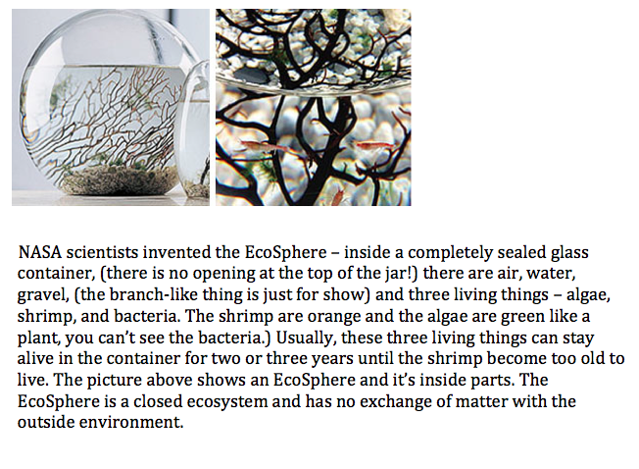
Ecosphere
Notes:
This is the item they are responding to in the following excerpts.

Slide 6
Level 2
Level 4
Jake
Allen
Level 2
INTERVIEWER: Do you think that matter changes from one form to another in the ecosphere? Why not or how does that happen?
LEVEL 2 STUDENT: Matter changing from one thing to another - I wouldn't really think so just because there's really no source to make it change. Everything in there is pretty natural
Notes:
Level 2 reponse to this prompt might sound like….
(From DLS_CH 2184_PRE).

Slide 7
Level 4
Level 4
Jake
Allen
Level 2
INTERVIEWER: Let’s see, so do you think that matter changes from one form to another in the ecosphere?
LEVEL 4 STUDENT: Matter as in - I think molecules - the atoms won’t change, but they’ll recombine with other molecules - with other atoms forming different molecules in whole system. But the atoms themselves are all the same.
Notes:
Level 4 might respond like…
(From DLS_CH 2184_PRE.)

Slide 8
Allen
Level 4
Jake
Allen
Level 2
INTERVIEWER: Okay. Do you think that matter changes from one form to another in the ecosphere?
ALLEN: Since there’s no exchange out—so yeah, probably. If it got really hot in there, the water would do like—evaporate into the space and then when it cooled, it would go back to its liquid form. So, definitely within the water.
INTERVIEWER: Okay. Does matter get used up when it changes form in the ecosphere?
ALLEN: No. There’s always the same amount whether of what state it’s in.
Notes:
Allen – doesn’t break laws of matter and energy
From DLS_CH 2184_PRE.

Slide 9
Jake
Level 4
Jake
Allen
Level 2
INTERVIEWER: So when the matter is changing forms, like you said, and making new molecules does any of the matter ever get used up?
JAKE: Yeah.
INTERVIEWER: Okay. How does that happen?
JAKE: Well it’s getting used up by the algae and the shrimp because they are consuming it to stay alive inside this orb. And it is being used up through them and being worked off through the physical energy that they’re creating.
Notes:
Jake is imprecise in his language and breaks the rules
(“used up,” “creating energy,” and “being worked off”).

Slide 10
Post-Interview Results
Level 4
Fact-Oriented Level 3
Jake
Allen
Level 2
Notes:
Allen moved up, Jake didn’t.
Excerpts are in the paper.

Slide 11
Allen
Level 4
Jake
Allen
Level 2
INTERVIEWER: So do you think matter changes from one form to the other in the ecosphere?
ALLEN: Yeah… I guess because molecules are being rearranged and a bunch of different processes throughout like the algae make their own food and then like the shrimp using the matter in different ways, breaking down the molecules and then also the bacteria breaking it down so there’s always change of atom groups. But then all the atoms still exist overall.
INTERVIEWER: So does the matter get used up when it changes form?
ALLEN: No, it’s constant.
Notes:
Allen sticks to rules.

Slide 12
Jake
Level 4
Jake
Allen
Level 2
INTERVIEWER: Okay. Does matter get used up in the ecosphere?
JAKE: Yes.
INTERVIEWER: Okay, how does that happen?
JAKE: It’s at the final stage on decomposers. Once everything is gone the decomposers have nothing else to feed upon, so that’s how it’s used up.
Notes:
MATTER/MATERIALS
Still says that matter gets “used up” and “everything is gone.” Not clear if he means that atoms are being rearranged to make new molecules or if he thinks the matter disappears. Not precise enough.

Slide 13
Hypothesis
Level 4: scientifically principled reasoning
Principle-Oriented Level 3
Fact-Oriented
Level 3
Allen
Jake
Level 2: force-dynamic discourse
Notes:
New Names for Jake & Allen
Not suggesting that there are only 2 ways to get to Level 4, or that you have to go through PL3 to get to 4.
We hypothesize that a student PL3 is positioned more productively. She will in a better position to move to L4 with principles-first instruction.
Why is this our hypothesis?

Slide 14
How are PL3 and FL3 alike?
context-specific knowledge
Notes:
If I ask a student how a plant gains mass, different than if I ask about fire, animal, decomopser. J&A have about the same CSK.

Slide 15
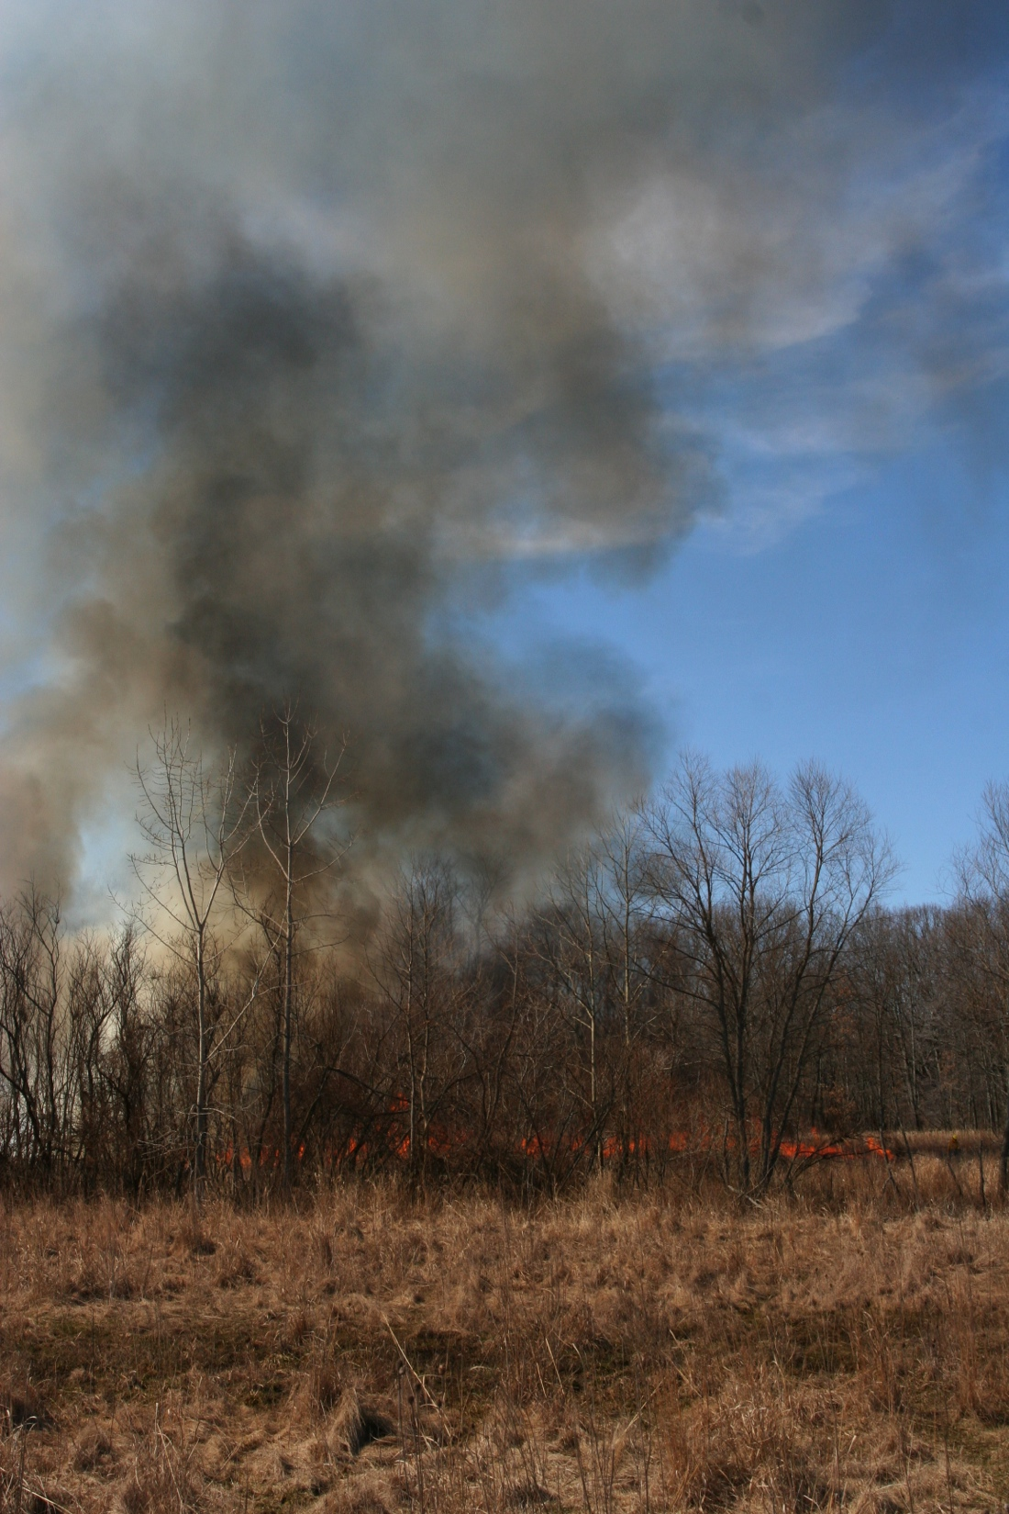
How are PL3 and FL3 different?
Principles of Matter and Energy
Matter cannot turn into energy
Atoms cannot be created or destroyed
Energy cannot be created or destroyed
Notes:
They are different because..Allen sees these things inside reasoning framework.

Slide 16
Implications for Teaching & Research
Most students are Level 2 students & Fact-Oriented students
Use coding scheme to code to look for similar patterns in K-12 populations
Theories of motivation?
Metacognitive tools in instruction?
Notes:
Bring Third point point back to principle vs fact (use jake & allen as example)

Slide 17
Challenges
Teaching: To use this in a classroom for formative assessment tool, teachers will need to identify patterns across contexts.
Research: Difficult to create coding scheme for individual items.

Slide 18
Questions

Slide 19
Notes:
What we look for consistency…
-Atom/molecule
-Matter/Material
-Energy/Matter
We look in isolation and also how they use them in context of natural systems

Slide 20
Levels of Achievement
Level 4: scientifically principled reasoning
Level 3: “messy middle”
Level 2: force-dynamic discourse
Notes:
(Andy will do this)

Slide 21
Consistency
Level 4
Level 4
Jake
Allen
Jake
Allen
Level 2
Level 2
✔
✔
✗
✔
✗
✔
Notes:
Fact-oriented vs principle oriented are aso different because….
Maybe take this out
Make the point that you have to look across items for this pattern.
Across Items, Jake is inconsistent, and Allen is consistent.
THERE IS SOME REPETITION HERE—
MAYBE MOVE THIS SLIDE AFTER 16? Maybe ok here (as not to return to J&A after go to model level) – the problem with having it here is that it takes extra time to

